Slide 1


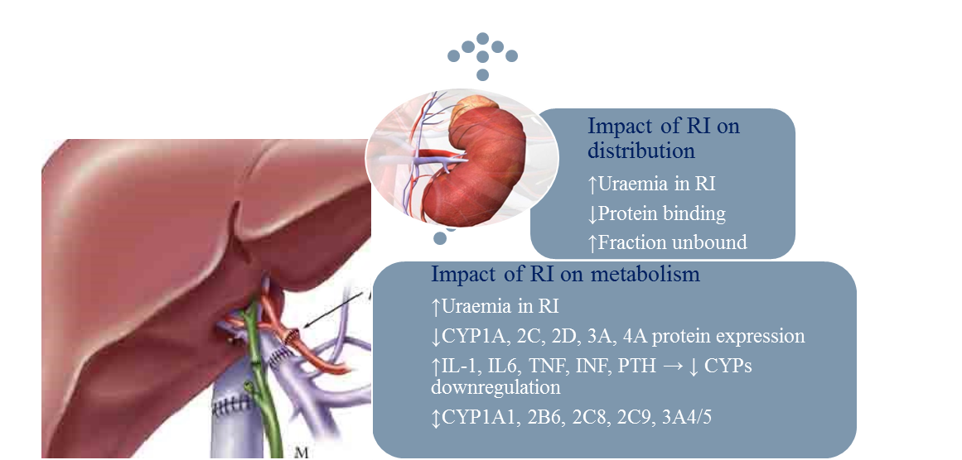
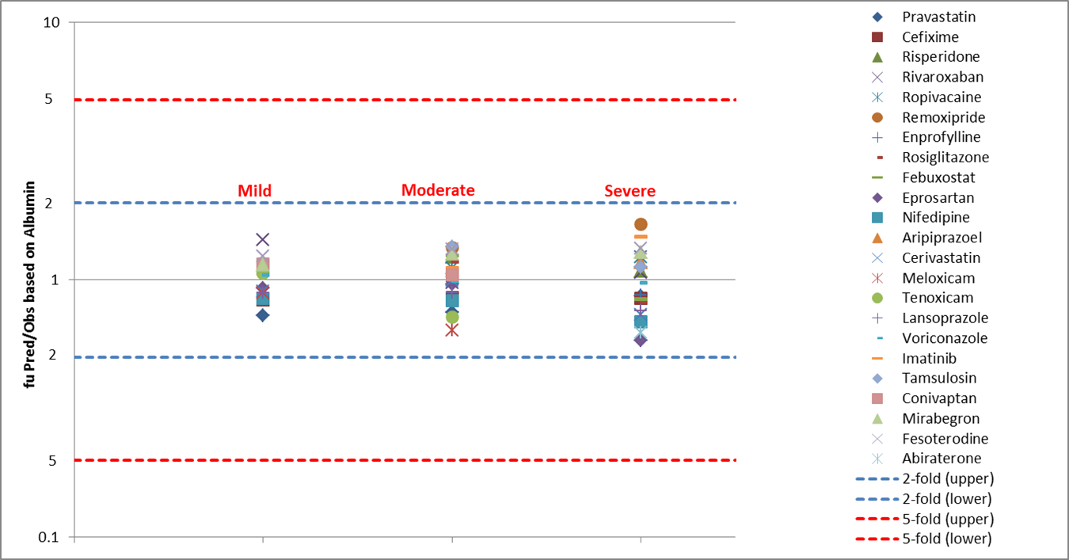
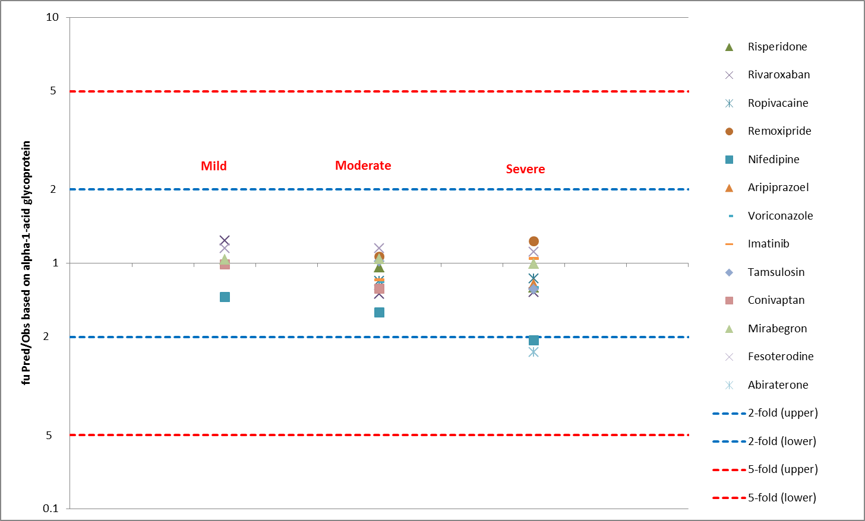
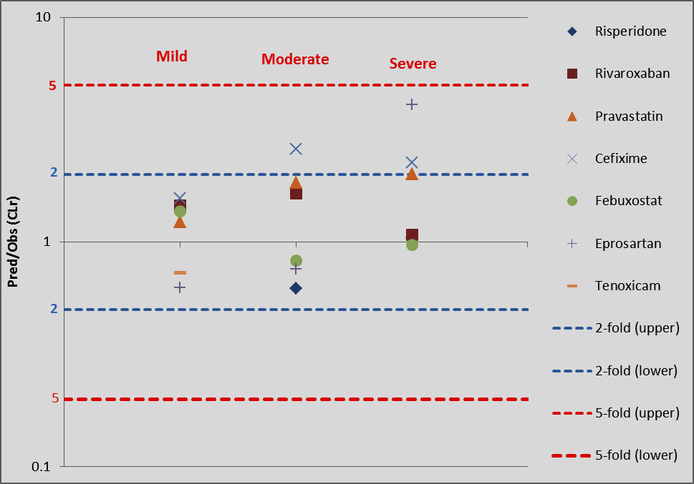
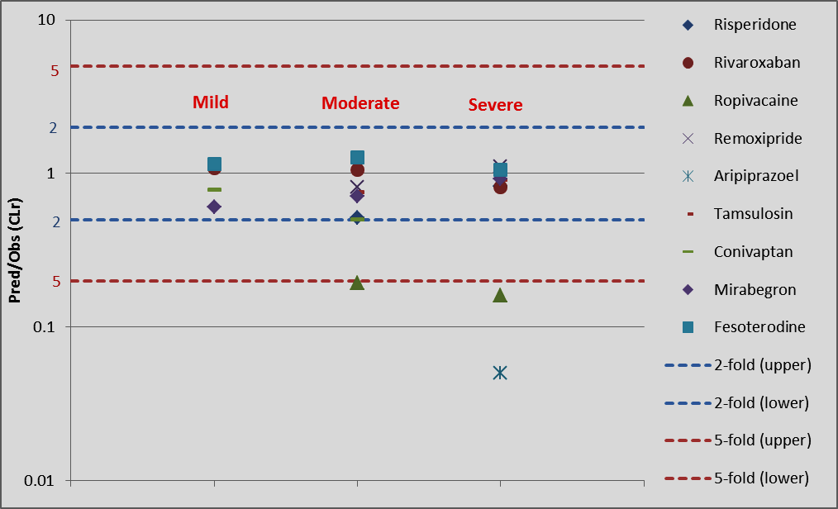
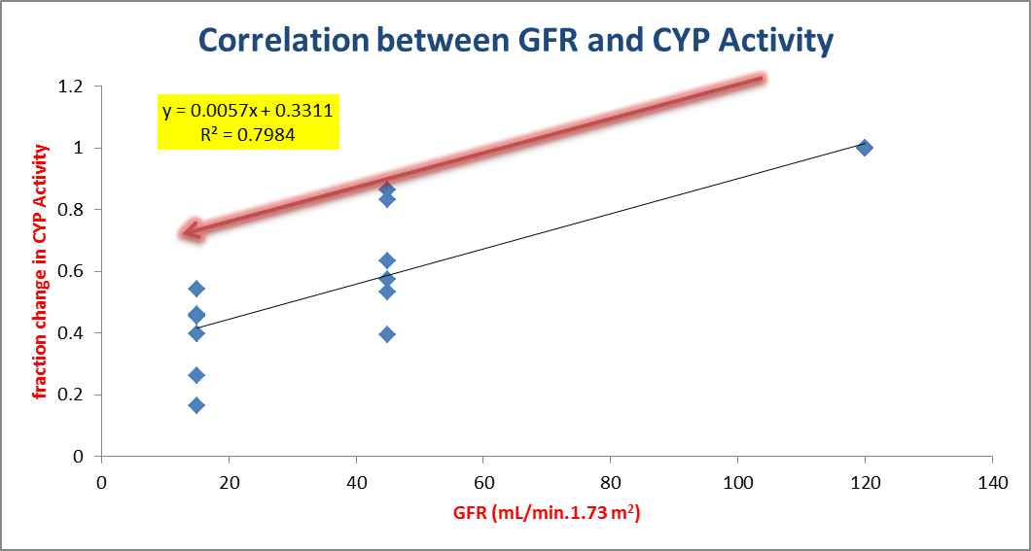
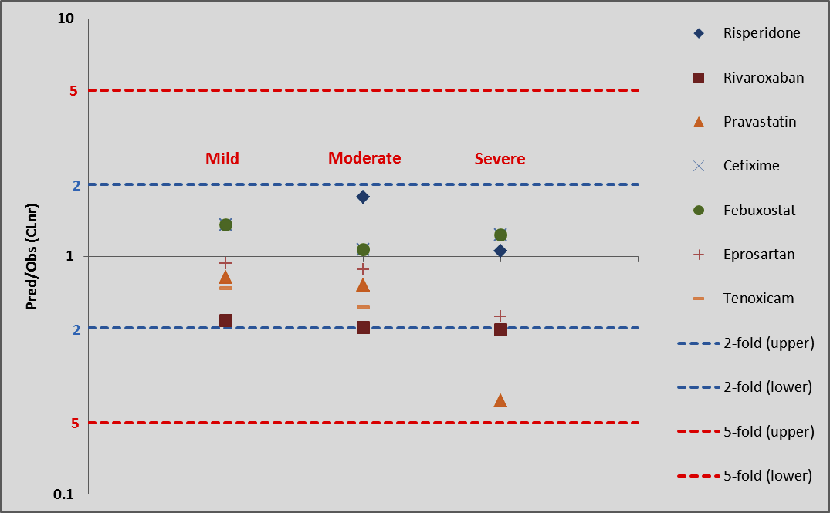
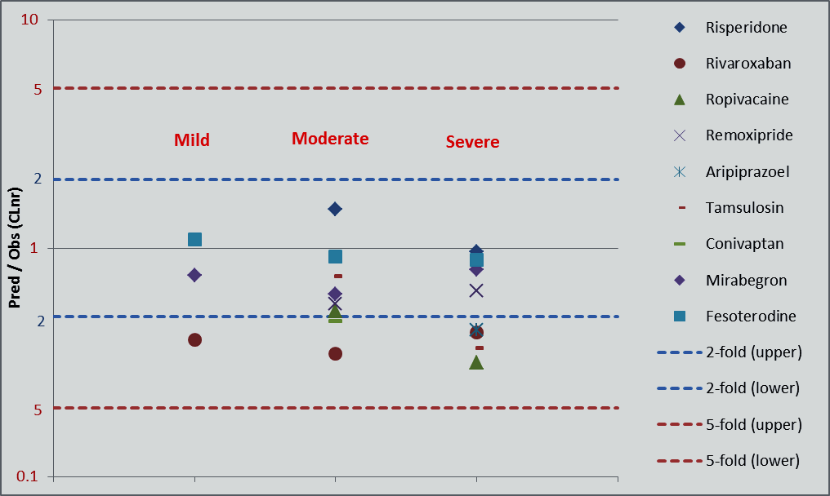
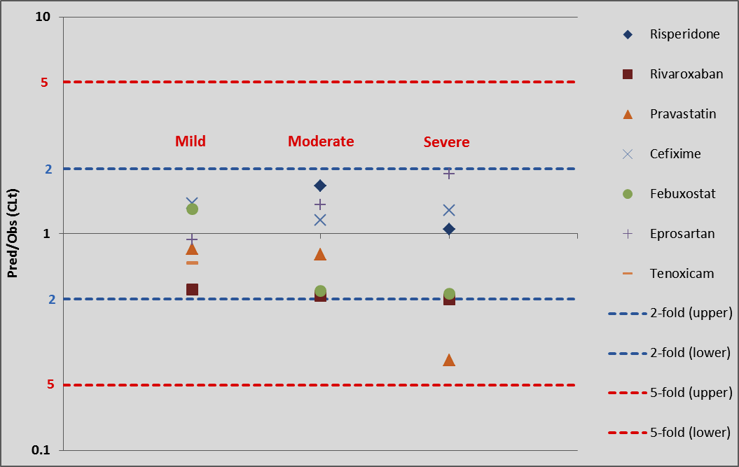
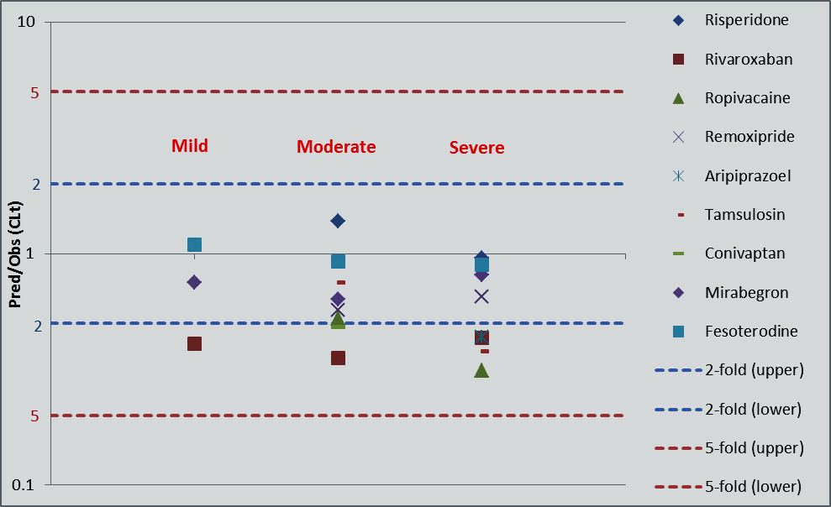
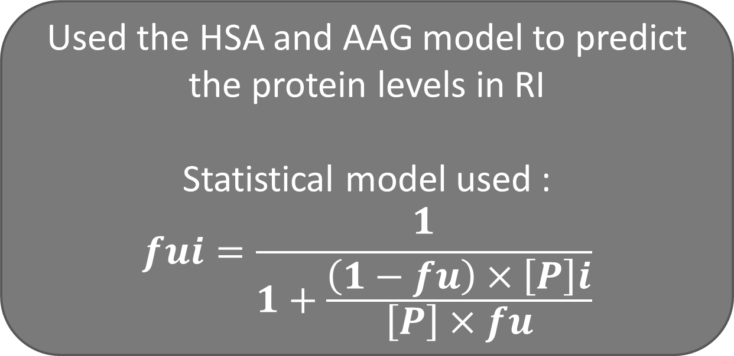
Predicting the Fraction Unbound (fu) and Plasma Drug Clearance Based on Known Changes in Albumin and Alpha1-Acid Glycoprotein Levels at Varying Degrees of Renal Impairment
Jokha Al Qassabi¹, Adam Darwich¹, Amin Rostami-Hodjegan^{1,2}
¹Centre for Applied Pharmacokinetic Research, University of Manchester, United Kingdom
³ Certara UK Ltd., Sheffield, United Kingdom
Background
Objectives
Renal impairment (RI) leads to physiological changes that can affect the pharmacokinetics (PK) of drugs.
Changes in fraction unbound in plasma (f_{u}) can be due to alteration in proteins levels (mainly human serum albumin (HSA) and α1-acid glycoprotein (AAG))
The main objectives of this study were to develop:
a model that can predict the f_{u} based on known changes in the levels of (HSA and AAG) at various degrees of RI for 23 drugs and,
(2) a model that can predict the clearance (CL) using the f_{u} model for 14 drugs at different stages of RI
Renal impairment studies (HSA, AAG, f_{u}, f_{e})in healthy and renal disease.
Database used: Cochrane library
(23 studies)
HSA Prediction
The data obtained from (Kopple et al., 2000)
Statistical Model used:
y=0.00005x^2-0.0004x+3.9875
AAG Predictions
7 RI studies were used
Statistical Model used:
y=-0.0031x2 + 0.3239x + 20.143
Methods
Figure 1. Physiological changes associated with RI.
1.Predicting Protein Levels
Results
2. Predicting fu
Used the HSA and AAG model to predict the protein levels in RI
Statistical model used :
$$fui=\frac{1}{1+\frac{\left(1−fu\right)×\left[P\right]i}{\left[P\right]×fu}}$$
Figure 3. fold error of predicted fu/obs based on HSA for the different renal impairment stages
3. Predicting CL
Used HSA, AAG, fu models to predict the CL in RI
CLr Predictions
CLr_{mild} = (CLr_{HV}*((GFR_{mild}*fu_{mild}) / (GFR_{HV}*fu_{HV})))
CLr_{moderate} =(CLr_{HV}*((GFR_{moderate}*fu_{moderate})/ (GFR_{HV}*fu_{HV})))
CLr_{Severe} = (CLr_{HV}*((GFR_{severe}*fu_{Severe}) / (GFR_{HV}*fu_{HV)}))
CLnr Predictions
CLnrPred_{mild}= (((Clnr_{HV}*fmCYPn*fraction of CYPn activity in mild) *(fu_{mild}/fu_{HV})
CLnrPred_{moderate}= (((Clnr_{HV}*fmCYPn*fraction of CYPn activity in moderate) *(fu_{moderate}/fu_{HV})
CLnrPred_{Severe}= (((Clnr_{HV}*fmCYPn*fraction of CYPn activity in severe) *(fu_{severe}/fu_{HV})
Figure 4. fold error of predicted fu/obs based on AAG for the different renal impairment stages
CL Predictions based on AAG
(7 basic)
(5 acidic)
(2 neutral)
CL Predictions based on HSA
Conclusions
The statistical models proposed in this study for f_{u} and CL seem to be predictive of the clinical data.
In the absence of measured protein levels this model can be of use.
Clearance and plasma protein binding predictions showed superior performance for HSA substrate drugs as compared to AAG, as more data was available to inform the HSA binding model.
Figure 2. Association between GFR and CYP Activity
References
Rowland Yeo, K. et al. (2011) ‘Modeling and predicting drug pharmacokinetics in patients with renal impairment’, Expert Review of Clinical Pharmacology, 4(2), pp. 261–274. doi: 10.1586/ecp.10.143
McNamara, P. J. and Alcorn, J. (2002) ‘Protein binding predictions in infants’, AAPS PharmSci, 4(1), pp. 19–26. doi: 10.1208/ps040104.
Life Options (2018). Kidney. [image] Available at: https://lifeoptions.org/living-with-kidney-failure/kidney-transplant.
Aarav Medicare (2018). Liver image. [image] Available at: http://aaravmedicare.com/treatmentoffered/Liver%20Transplant.aspx.
Figure 5. Clearance Prediction based on HSA model
Figure 6. Clearance Prediction based on AAG model
This research was supported by Oman Government
jokha.al-qassabi@postgrad.manchester.ac.uk

